Slide 1
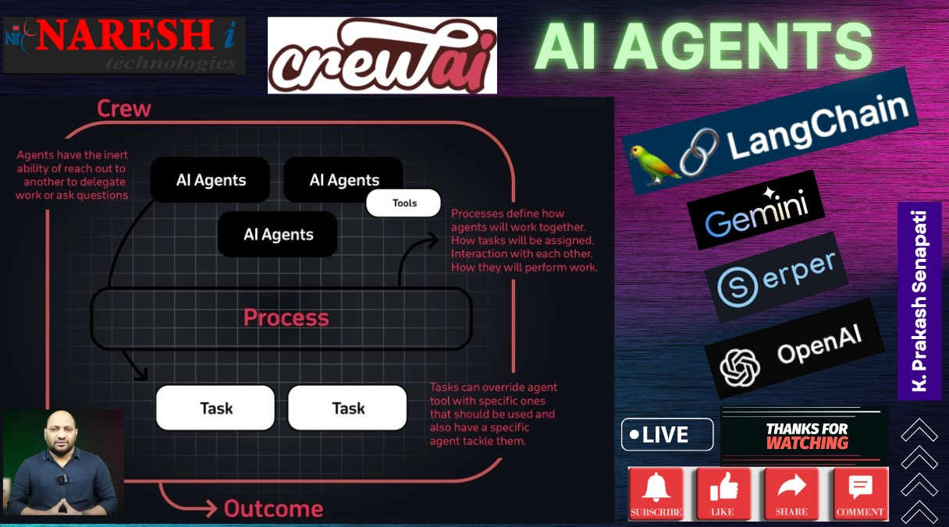

Slide 2
AGENDA
My Introduction
Data Science Glance
What CREW AI Agents & let’s understand few example of AI Agents
LLM model’s vs CREW AI Agent’s
1st PROJECT – Crew AI Integration with OPEN AI api key & SERPER api key
2nd PROJECT – Crew AI Integration with Gemini, LangChain, Duckduckgo
About New Batch schedule date, time , duration
Generative AI & LLM models previous classes recording
Question & Answer
Like, subscribe & comments on my every videos

Slide 3
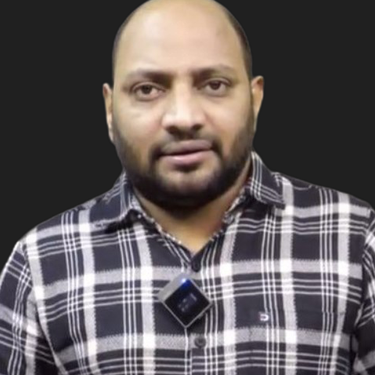
MY INTRODUCTION
LEAD DATASCIENTIST @ NARESH IT → K. PRAKASH SENAPATI
INDUSTRY EXPERIENCE → 17+YRS
WORK EXPERIENCE→ KROGER IT | GENPACT | VALUELABS | MPHASIS | ITFAS | KIABI | A3MAX |
TEACHING EXPERIENCE → SYNERGISTIC SOFTWARE SOLUTIONS | IIIT-BANGALORE UPGRADE |
GREAT LEARNING | CORPORATE TRAINER | NARESH IT
PERMANENET WORKING CLIENT → EUROPEAN BASED CLIENT
TRAINING MODE→ OFFLINE & ONLINE
OFFLINE LOCATION→ AMEERPET, HYDERBAD
OFFLINE LAB → PHYSICAL LAB & ONLINE LEARNER → VIRTUAL LAB
DURATION→ 5-6 MONTHS & TIME →8:30AM
CLASS DAY→ MON - FRI || 2nd & 4th WEEK– SATURDAY
MICROSOFT CERTIFIED DATASCIENTIST
GOOGLE CERTIFIED GENERATIVE AI ENGIEER
LINKEDIN →https://www.linkedin.com/in/kodi-prakash-senapati-a95a60182/

Slide 4
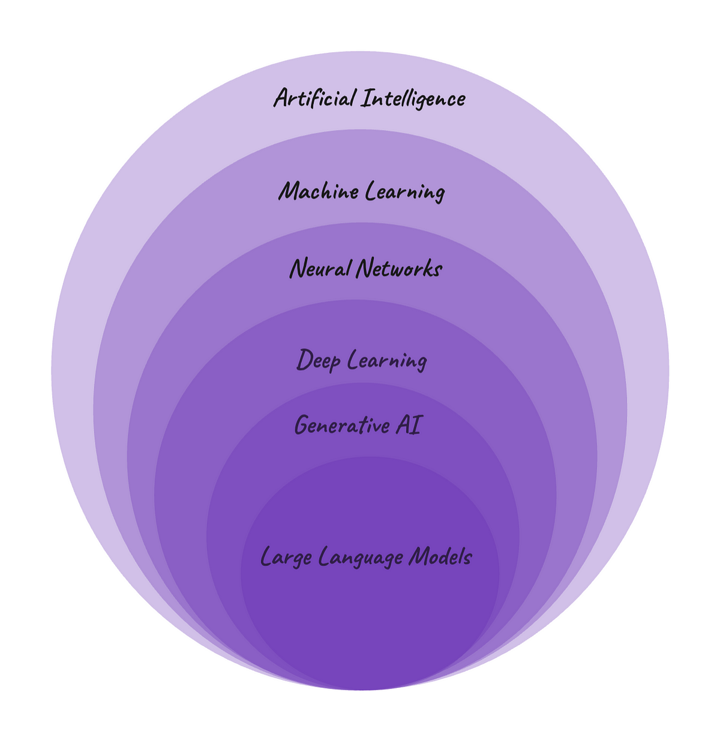
DATA SCIENCE
SUPERVISED LEARNING
UNSUPERVISED LEARNING
REINFORCEMENT LEARNING
MACHINE LEARNING
ARTIFICIAL ITELLIGENCE
GENERATIVE
Artificial Intelligence
NLP
LLM MODELS
REGRESSION
CLASSIFICATION
DEEP LEARNING
NEURAL NETWORK
OPEN AI
CLUSTERING
CREW AI
GOOGLE
AI AGENTS
SUPER AGI
META
CLAUDE
Unfetch

Slide 5
WHAT IS CREW AI
Imagine you run a bakery, and you need help managing different tasks like taking orders, baking, and delivering products.
Instead of hiring people for each job, you have a team of virtual assistants (AI agents) that can do these tasks automatically.
One assistant takes orders, another prepares the recipes, and a third handles deliveries
Crew AI acts like the manager, ensuring that all these assistants communicate and work together smoothly to run your bakery without you having to constantly oversee each task.
Ai agents are intelligent systems that can perform multiple tasks autonomously.
AI agents learn over time, making decisions and taking actions, from customer service to content creation.
AI agent is like a smart digital helper that can make decisions and take actions on its own.
Crew ai is a multiple ai agents, each agent playing a specific role, similar to a human team & its primary strength lies in organizing these agents to work together efficiently to complete complex tasks.
Crew ai is particularly useful for automating multi-agent workflows in tasks like content creation, stock analysis, and email management.
Crew ai integrates with various large language models (llms)

Slide 6
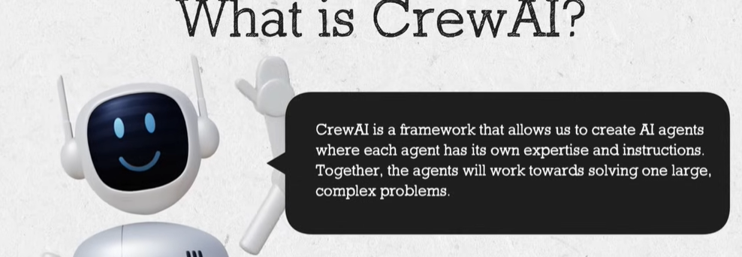
INTRO TO CREW AI
Request to refer to the official website → https://www.crewai.com/
Refer to the documents → https://docs.crewai.com/
Crew ai github → https://github.com/crewAIInc/crewAI

Slide 7
LLM MODELS vs CREW AI AGENTS
LLMs (Large Language Models):
Their primary function of llm models is to process and generate language, answer questions, write content, image generation and can answer complex questions, write essays, summarize articles, and engage in detailed conversations.
They are highly generalized models, meaning they can handle a broad range of tasks like answering questions, generating text, or translating languages.
LLMs: Best suited for applications like conversational AI (chatbots), content creation, customer support, translation, summarization, or coding help.
Example: A business using GPT-4 to generate customer service responses or to summarize documents.
CREW AI Agents:
Crew AI focuses on multi-agent collaboration, where several specialized AI agents work together to accomplish complex tasks. Each agent might be responsible for a specific function, and Crew AI manages how they communicate and collaborate.
Example: In a project management scenario, one Crew AI agent might handle scheduling, another tracks progress, and another communicates with clients, all working together to achieve the overall goal.
Each agent is more specialized. Instead of one model trying to do everything, multiple agents with different specializations work together, each handling specific parts of a larger task.
A company using Crew AI to automate its sales pipeline, where one agent tracks leads, another schedules meetings, and a third handles email communications.

Slide 8
1st PROJECT: CREW AI INTEGRATION WITH OPEN AI API & SERPER API KEY
Software application – GOOGLE COLAB
Reference – GITHUB CREW AI
LLM MODEL – OPEN AI API KEY (PAID ONE) → PLATFORM.OPENAI.COM
SERPER API KEY → https://serper.dev/
WHAT IS SERPER ?
SERPER IS AN API THAT ALLOWS DEVELOPERS TO RETRIEVE GOOGLE SEARCH RESULTS IN A STRUCTURED FORMAT. IT CAN BE USED TO PULL SEARCH DATA, SUCH AS WEB PAGES, NEWS ARTICLES, AND SUMMARIES, AND INTEGRATE THEM INTO OTHER APPLICATIONS. THIS IS PARTICULARLY USEFUL FOR BUILDING SEARCH FUNCTIONALITIES WITHIN APPS WITHOUT RELYING DIRECTLY ON GOOGLE'S TRADITIONAL INTERFACE.
FOR EXAMPLE, DEVELOPERS CAN USE THE SERPER API TO AUTOMATICALLY FETCH AND SUMMARIZE NEWS ARTICLES RELATED TO SPECIFIC SEARCH QUERIES, MAKING IT EASIER TO GENERATE QUICK INSIGHTS FROM GOOGLE SEARCH RESULTS. THE API IS COMMONLY USED IN CONJUNCTION WITH TOOLS LIKE LANGCHAIN, WHERE IT HELPS STREAMLINE WORKFLOWS BY COMBINING SEARCH AND AI-GENERATED SUMMARIES, SUCH AS SUMMARIZING SEARCH RESULTS USING MODELS LIKE GPT
THIS TOOL CAN BE HELPFUL FOR BUILDING APPS THAT NEED TO DISPLAY SEARCH CONTENT OR ANALYZE SEARCH RESULTS PROGRAMMATICALLY, MAKING IT A FLEXIBLE RESOURCE FOR DEVELOPERS.

Slide 9
2nd PROJECT – Crew AI Integration with Gemini, LangChain, DuckDuckgo
Software Application → Google Collab
Crew AI → from crewai import Agent, Task, Crew, Process
duckduckgo-search || huggingface_hub || langchain_google_genai
DuckDuckGo-Search:
Purpose: DuckDuckGo Search API provides a way to query the DuckDuckGo search engine, which is known for privacy-focused search results.
Use Case: It’s widely used to fetch web search results without user tracking or ad profiling, making it a popular choice for privacy-conscious developers.
Huggingface Hub:
Purpose: Huggingface Hub is a repository and API platform for hosting and sharing machine learning models, datasets, and tools, particularly focused on natural language processing (NLP) models such as BERT, GPT, etc.
Use Case: Developers use it to integrate pre-trained models into applications like chatbots, translation systems, or any AI-driven text generation tasks.
Langchain Google GenAI:
Purpose: This is part of the Langchain framework, which allows developers to build applications with language models and integrate them into various tools. The Google GenAI tool leverages Google’s generative AI for NLP tasks.
Use Case: It allows developers to build applications that combine Google’s powerful AI with Langchain’s toolkit, enabling complex workflows such as dynamic document generation, intelligent search, and summarization.

Slide 10
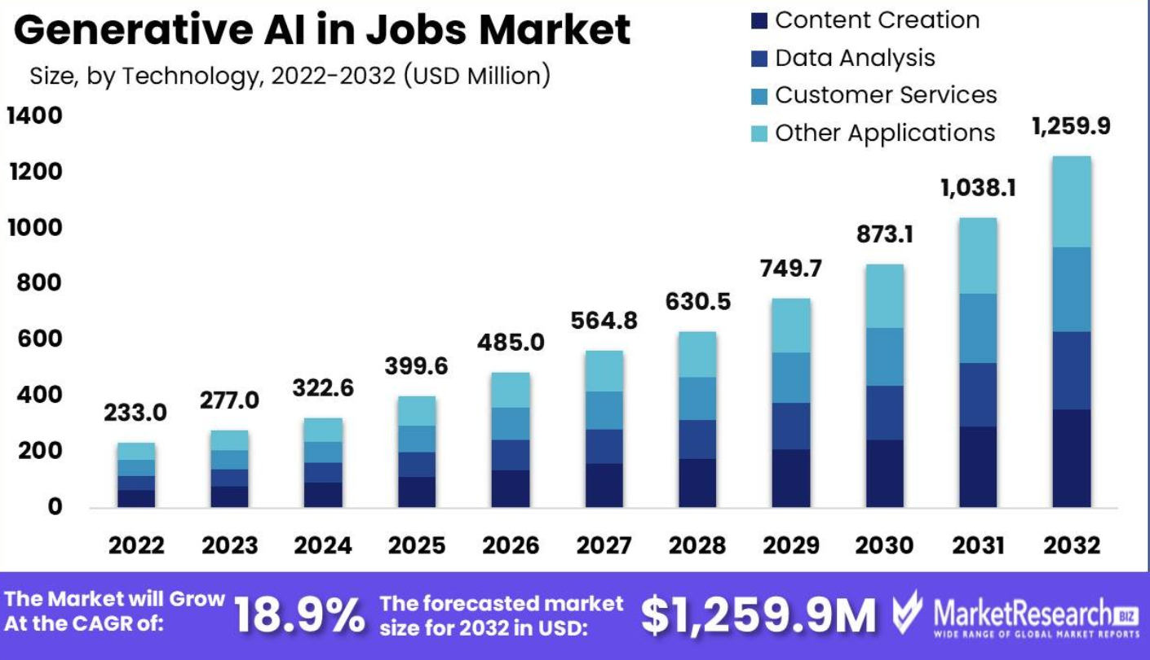
8GENERATIVE JOB MARKET 2024- 2030 AS PER MARKET RESEARCH
Generative Ai in Jobs Market Segmentations : -
Based on Application
Content Creation
Data Analysis
Customer Services
Other Applications
Based on Technology
Natural Language Processing
Computer Vision
Machine Learning
Other Technologies
Based on Job Field
Marketing
Human Resource
Research
Other Fields

Slide 11
GENERATIVE AI SESSION
1- ChatGPT Tutorial for Developers | Introduction to ChatGPT : youtube.com/watch?v=SDStCnlITT8
2- Generative AI Workshop : youtube.com/watch?v=Xp1MnygECUs
3- LARGE LANGUAGE MODEL : youtube.com/watch?v=v0w9LXXrsys
4- COMPLETE DATA SCIENCE LIBRARY: youtube.com/watch?v=MsFhUjFL4vE&t=209s
5- Know About Data Science & Generative AI: youtube.com/watch?v=TR_OCx5z-m8
6- Generative AI with Langchain, Langsmith, OpenAI & LLMops
youtube.com/watch?v=MAkXifYHnuw&t=1320s
7- Google Generative AI | Gemini AI: youtube.com/watch?v=BDrXdvNh19Q&t=5684s
8- Generative AI for Build LLM Model Using Lama 3,Hugging Face & Ollama
youtube.com/watch?v=eDN6fAWLNNE&t=5425s
9- GEMMA-9B Integration with GROQ, HUGGINGFACE & LANGCHAIN
youtube.com/watch?v=Bp1XyvMvedg&t=7086s
10- NLP: youtube.com/watch?v=s-xhKH-e8ig&t=5844s
11- RAG: www.youtube.com/watch?v=8nWjvn8ZKtU&t=7553s

Slide 12
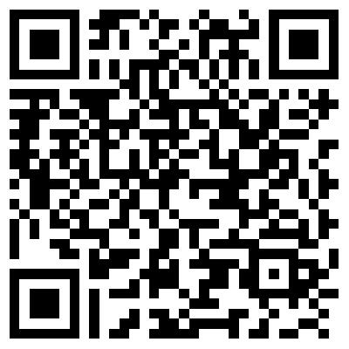
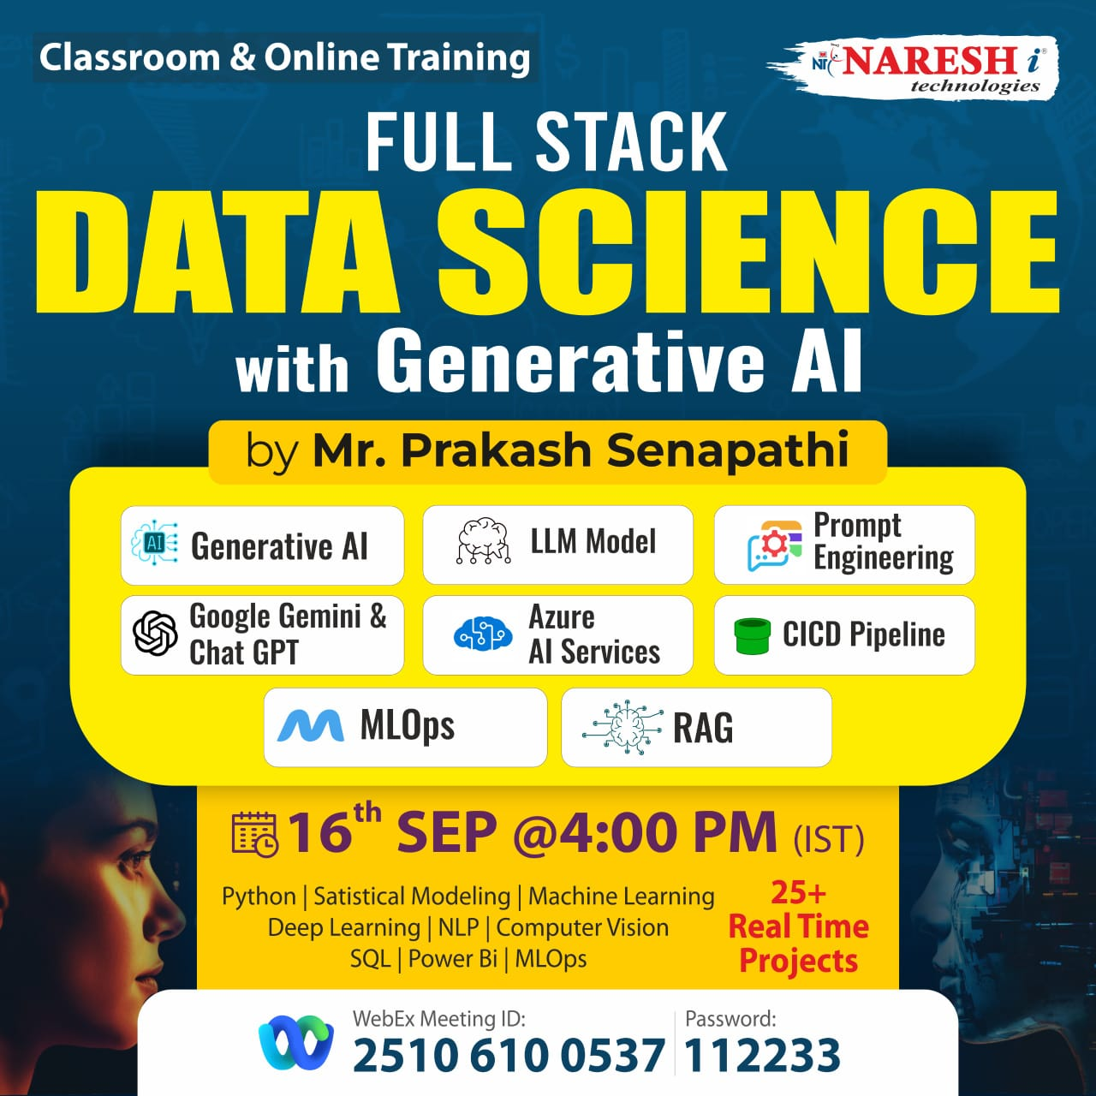
New Training Batch offline & online
Full Stack DATA SCIENCE, AI, Generative AI | Dt: 16th Sep @ Timing 4pm
Joining URL: https://web.webex.com/join-meeting
Meeting Id: 2510 610 0537 & Password: 112233

Slide 13
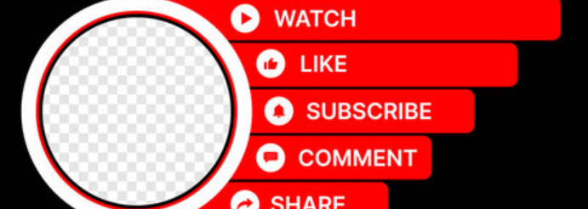

https://drive.google.com/drive/u/0/folders/1sHsaHEf4-e8VwFI2GLu8pWDZIlzhZB_4

